Slide 1
Machine Learning Approach to Predict the mechanical behaviour of alumina at various weight fractions
George Felobes
September 8, 2022

Slide 2
Background
Experimental setup
Analytical model
Numerical model – limitation is the computational expense

Slide 3
Objective
Predict the shape of stress-strain curve (within 10%)
Yield strength
Deformation failure point
General shape of the curve
Size, type of loading (eg: tensile), and loading rate
Expand the model to account for porosity (linear relationship with WF), particle

Slide 4
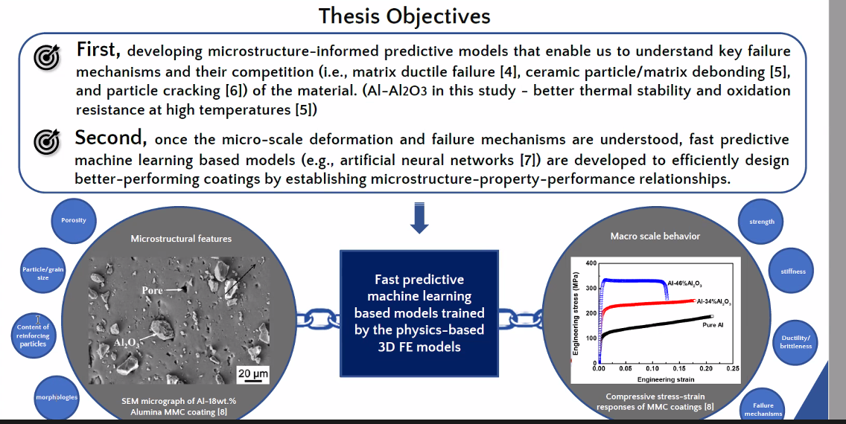

Slide 5
Data
Given data: 5 stress-strain curves at various weight fractions
Data summary in ipynb

Slide 6
Methodology (get a flowchart showing the process)
Visualization and EDA
Feature Engineering
Data split to training and testing
Modelling (supervised machine learning)
Testing and validation

Slide 7
Modelling Methodology
Linear regression
Polynomial regression
SVM regressor
Random forest regressor
Deep learning using ANN

Slide 8
Functions created
Youngs modulus
Yield strength – use Kmeans algorithm
Ductile failure – some form of interpolation
Toughness – integration of area under the graph
Function to make the number of points consistent (linear interpolation to increase points, or averaging aggregation to decrease points

Slide 9
Paper 1: DL to estimate biaxial stress-strain curves of sheet metals
Input: 3D orientation map (crystallographic texture) and stress ratio
Method: Deep neural networks
Output: stress strain curves

Slide 10
Paper 2: CNN to predict stress strain curve of composite microstructure
Input: microstructure
Method: CNN + PCA. CNN used to make predictions in PCA coordinate space with the loss function weighted by the explained variance ratio of each component. Reverse PCA to get stress strain curves.
Output: stress strain curves

Slide 11
A Comparative Study of Strain Rate Constitutive and Machine Learning Models for Flow Behavior of AZ31-0.5 Ca Mg Alloy during Hot Deformation
The six ML algorithms used in this study are gradient-boosted trees (GBT), deep learning (DL), random forest (RF), decision tree (DT), general linear model (GLM), and support vector machine (SVM)
first metric is the mean squared error (MSE)
correlation coefficient (R2 )

Slide 12
RVE – representative volume element from digimat

Slide 13
Overfitting
Overfitting in general can be a problem of an overabundance of features, an overextended training epoch, or a gross over-parameterization of algorithm parameters in the training dataset

Slide 14
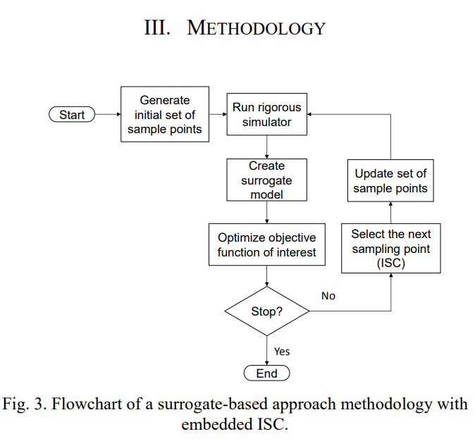
Surrogate modelling
Kriging model
Splines
ANN
Diffuse approximation
Determine the minimum number of numerical experiments required to generate a surrogate model to replace the numerical simulation

